Slide 1


Slide 2

UNIT -1 - IDOR

Slide 3
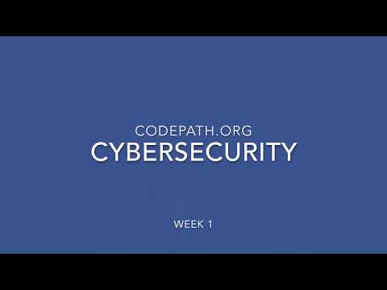
Notes:
Play this video in class to give students an overview of what’s going on in unit 1

Slide 4
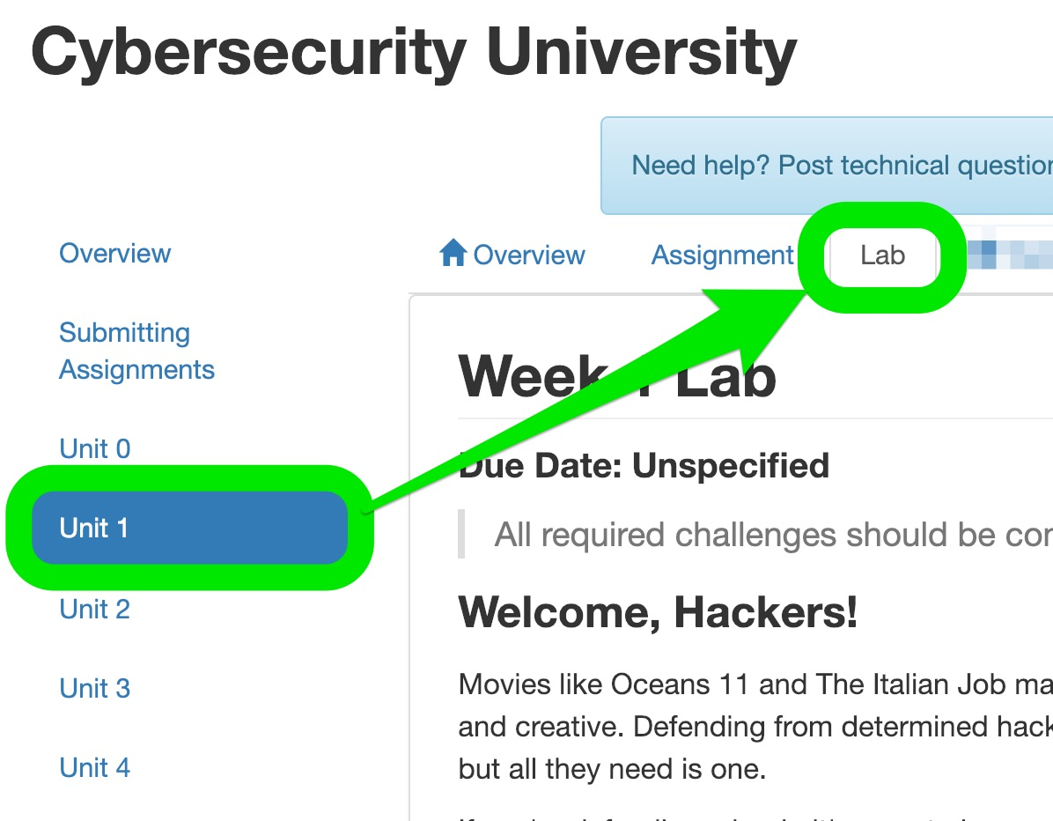
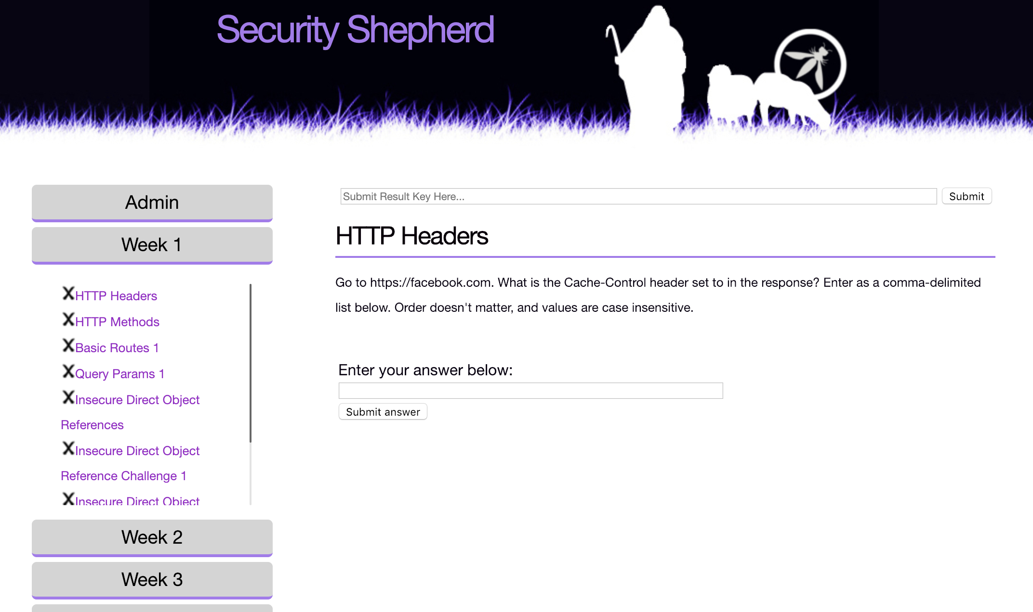
L
A
B
Course Portal
Security Shepherd
Lab Tab
Lab Platform
Notes:
This unit has 2 main parts
A lab portion which uses Security Shepherd Platform
An Assignment portion which uses the CTF Platform (Capture the Flag)

Slide 5
S
U
B
M
I
S
S
I
O
N
S
Lab + Assignment Deadline
📬 Midnight before the first session of next week
Notes:
Check the course portal for the posted deadlines for lab and assignments,
You can also remember it as midnight before the next week’s first session.
Remember, each unit has at least 1 deliverable, this unit it’s 1x lab (Security Shepherd) and 1x assignment (CTF)

Slide 6
GETTING ASSISTANCE

Slide 7
DISCUSSIONS
Notes:
Visit the Discussions Forum anytime you have a question, bug, crash, curiosity or anything else related to coursework. ☝️ Just click the link in the blue box at the top of the Course Portal.
Browse and search any question ever asked throughout all runs of this course. You can search by tag, project or keyword.
Post a question of your own, providing a description of the issue, screenshots, tags and repo link to help CodePath staff and the entire cohort network quickly get to the bottom of your problem. We'll even download and run your project ourselves to help debug if needed.
Answer questions posted by other students. Remember what we said about the importance of teaching? It's one thing to build a project and work though your own bugs, but solving someone else's issues is next level. Everyone in the cohort is encouraged to try their hand and answering questions, students, Tech Fellows and CodePath staff alike. You'll even earn a spot on our leaderboard.

Slide 8
Coursework Policies
3x 48 hr extensions no questions asked
Only one extension can be applied per assignment / milestone
After 3 extensions have been used you’ll receive a grade for whatever state your project is in at the deadline.
I.e. no submission = 0pts, 70% of required features = 70%

Slide 9
TOPIC INTRODUCTION: WHAT IS IDOR

Slide 10
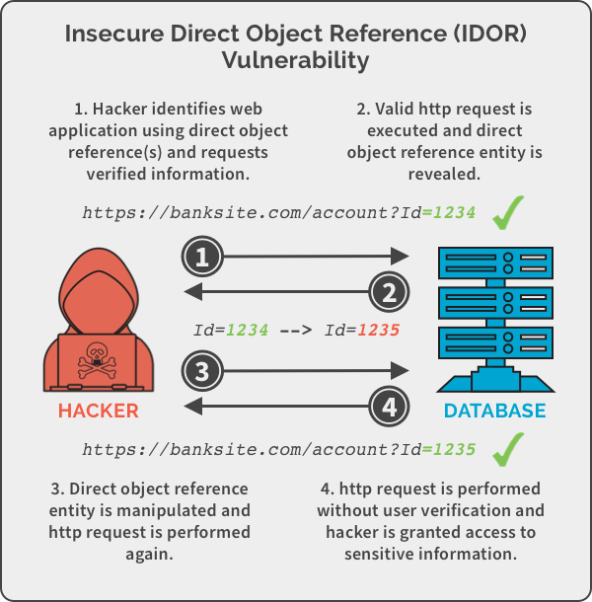
Overview:
Insecure direct object references (IDOR) are a type of access control vulnerability that arises when an application uses user-supplied input to access objects directly.
In other words, a poorly designed application exposes unauthorized content wherein the code access restricted resources based on user input but fails to verify the user authorization and authentication.
There exists a “direct” reference to an “object” which is “insecure” (i.e.) restricted.

Slide 11
Examples
https://insecure-website.com/customer_account?customer_number=132355
https://www.example.com/transaction.php?id=74656
http://yourbank.com/profile?userID=103
https://insecure-website.com/static/12144.txt

Slide 12
Preventive mechanisms to avoid IDOR based attacks
Access Control
Change the Direct object reference to an indirect object reference

Slide 13
Preventive mechanisms to avoid IDOR based attacks
Access Control
The primary prevention is to validate a user's authorization before allowing access to a privileged resource. It require a user to log in and confirm that logged in users have sufficient access privileges.
It is also possible to whitelist acceptable input and reject input which are not allowed.

Slide 14
Preventive mechanisms to avoid IDOR based attacks
Changing Direct object reference to an indirect object reference:
Another prevention strategy is to change the direct object reference to an indirect object reference. One way would be to provide a user a list of choices which are specific to that user, which are meaningful only for that user's context.
Instead of using direct references in the URL www.example.com/credit/profile/id#12, use indirect references www.example.com/c/ab. Then, refer to the indirect reference map to look for the actual reference. This way, direct references containing users’ credit card information will not be exposed.

Slide 15
Burp Walkthrough:
Install the Burp Community edition
Install Foxyproxy extension on morzilla firefox and change the address to route through 127.0.0.1 and port 8080.
Open Burp and go to proxy – intercept and turn off Intercept
Install the Burp CA Certificate
Check the Https traffic history on burp and if it is available, then the installation is complete

Slide 16
Hands On + Demo
Sign into the courses.codepath.com website
Sign into Security Shepherd
Sign into CTF
Demo of CTF 1.00 - Hidden Employee
Do the Lab Assignments and Capture the Flag

Slide 17
Wrap-Up and Remainders:
The assignment (CTF) and lab (Security Shepherd) are due by the posted deadline. (11:59pm before next week’s session)
Get started early so when you run into issues, you have time to use resources like the CodePath Discussions forum!
Notes:
Reminders
The assignment (CTF) and lab (Security Shepherd) are due by the posted deadline
Get started early so when you run into issues, you have time to use resources like the CodePath Discussions forum!

Slide 18
Next Week
Cookies and Session Based Attacks
We will learn how attackers can forge requests, steal cookies, and hijack browser sessions to gain access to privileged actions.

Slide 19
Questions??

Slide 20
See You Next Session! 🚀

Slide 21
Reference and Resources
https://courses.codepath.com/courses/cybersecurity_university/unit/1#!exercises
https://portswigger.net/burp
https://spanning.com/blog/insecure-direct-object-reference-web-based-application-security-part-6/
https://portswigger.net/web-security/access-control/idor
https://www.acunetix.com/blog/web-security-zone/what-are-insecure-direct-object-references/

